Slide 1
Big Mountain
Montana
Should the resort change the ticket price?

Slide 2
Big Mountain Resort offers...
Glacier National Park and Flathead National Forest
Access to 105 trails
Accommodation to skiers and riders of all levels and abilities
11 lifts, 2 T-bars, and 1 magic carpet for novice skiers
The longest run is named Hellfire and is 3.3 miles in length. The base elevation is 4,464 ft, and the summit is 6,817 ft with a vertical drop of 2,353 ft.

Slide 3
Questions to be answered...
Should the prices of ticket be changed?
currently follows a pricing strategy to charge a premium above the average price of resorts in its market segment
Does this take the advantage of the geographical features and the facilities that Big Mountain has? - This has been a doubt!
How should the prices be set?
What are the features to look into?
Should they add more features or remove existing facilities?
How to cut down the operational costs?
Should they remove some existing facilities to bring down the operational cost?

Slide 4
The Helpful Features...
FastQuads
High in the league table with 3 fastquads when most of the resorts don’t have one
Runs
Having one of the longest runs, and is doing well with the number of runs as well
Snow Making area
Very high up in the league table
Vertical Drop
Doing well with this feature

Slide 5
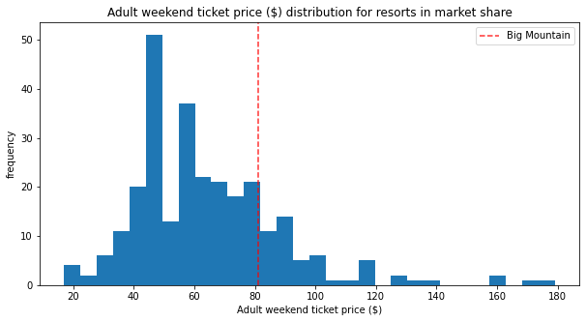
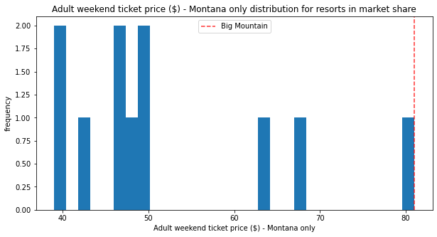
Distribution of the prices in the market & within Montana

Slide 6
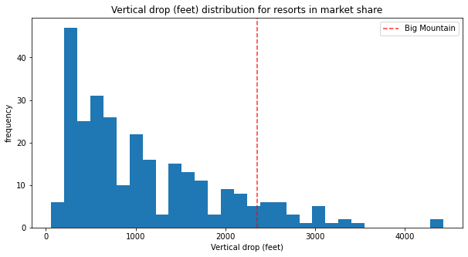
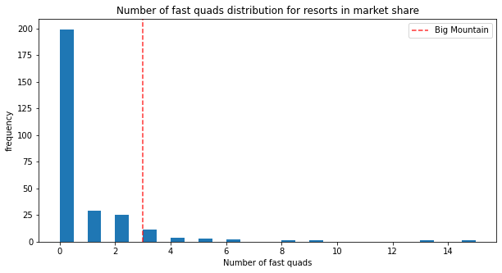
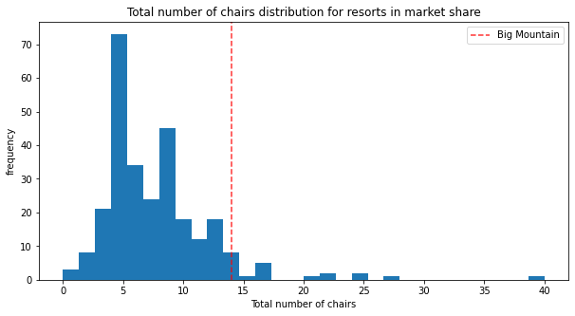
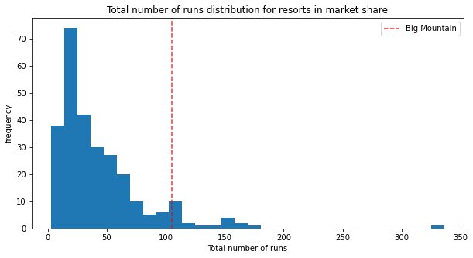
Distribution of favoring features

Slide 7
Various Scenarios:
Scenario 1: Changing list of the features 'Runs', 'vertical_drop', and 'total_chairs' by associated deltas of 1, 150, and 1, increases support for ticket price by $1.32, over the season, this could be expected to amount to $2307971.
Scenario 2: Changing list of the features 'Runs', 'vertical_drop', 'total_chairs' and ‘Snow Making_ac’ by associated deltas of 1, 150, 1, and 2 increases support for ticket price by $1.99, over the season, this could be expected to amount to $3474638.

Slide 8
Modeling Analysis - Findings
The current market will bear price increase from $85.48 to $106.26, the current price being $81.
With the expected number of 350000 visitors over the season skiing for 5 days on an average, this will increase the revenue between $7.8M ($4.48/ticket/day) to $44.2M ($25.26/ticket/day).
The analysis also showed that increasing the vertical drop by 150 ft and adding an additional chair, allowed the ticket price increase upto $1.99, leading to the revenue increase of $3.47M which justifies the operational cost of $1.54M for one additional chair.
As per the model, closing one least used run did not show any effect on revenue, though this run can be opened and closed on a weekly basis and the impact can be recorded.

Slide 9
Recommendations
Out of 32 features that were available for study, 4 features that have impact over the ticket prices are FastQuads, Runs, Snow Making area and the Vertical Drop.
Using these 4 features for the analysis, following business recommendation has been made:
Increase the ticket price by the minimum mentioned above from $81 to $85.48. Check the impact over a period of time. The price can be increased upto $106.26.
As per the model, closing one least used run did not show any effect on revenue, though this run can be opened and closed on a weekly basis and the impact can be recorded.
The analysis also showed that increasing the vertical drop by 150 ft and adding an additional chair, allowed the ticket price increase upto $1.99, leading to the revenue increase of $3.47M which justifies the operational cost of $1.54M for one additional chair.

